Slide 1
Finding the right neighborhood in a new city
Coursera capstone final project

Slide 2

Moving to a unknow area?
Professional reasons
Personal reasons
No housing option in neighborhood of interest
…

Slide 3

How to find the right neighborhood?
Use a recommendation system
Input:any neighborhood of preference, from any area
Output: similar neighborhoods in city of interest

Slide 4

How?
Retrieve venues from foursquare for neighborhood in city of interest
Recommond similar cities based on venues from input neighborhood

Slide 5
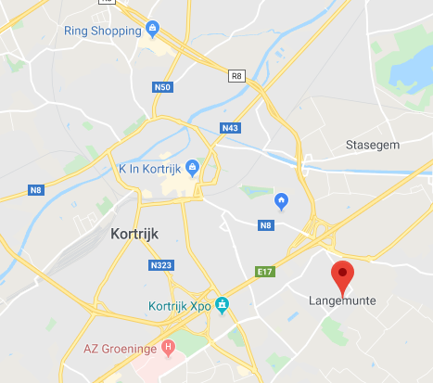
An example “Lange Munte”
As an example, the neighborhood Lange Munte, Kortrijk Belgium was chosen as input
In this example New York was chosen as target region

Slide 6
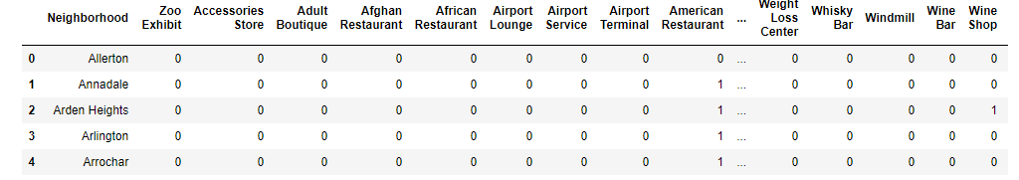
An example “Lange Munte”
Venues for each neighborhood in New York were retrieved from Foursquare, and transformed into a binairy matrix

Slide 7
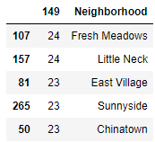
An example “Lange Munte”
A recommendation system was build using this neighborhood matrix to find neighborhoods resembling “Lange Munte” most.
Top 5 resembling venues

Slide 8
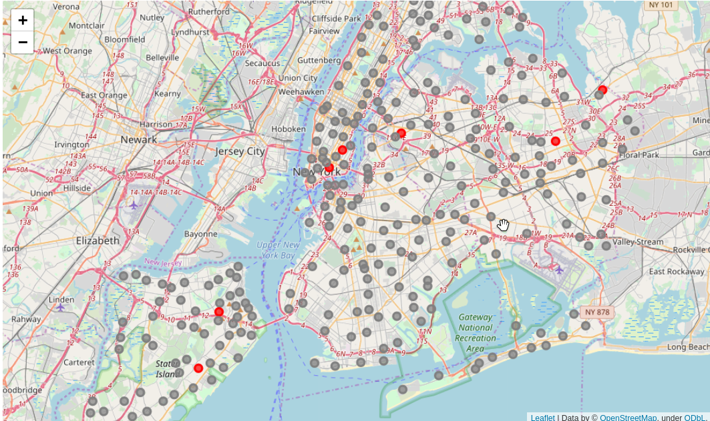
An example “Lange Munte”
These neighborhoods (red) had indeed most venues in common

Slide 9
Conclusions
A recommendation system was made to recommend neighborhoods in a foreign city based on a preferred neighborhood
An example has been worked out for Lange Munte
Can be used by real estate agents, government or as an application to provide a more personal approach on housing opportunities in an area based on the costumers preferences

Slide 10

Future Perspectives
Include preferences from other users (after building a database)
Allow user defined preferences, requirement en constrainsts for venues
Multiple inputs for better predictions

